Slide 1
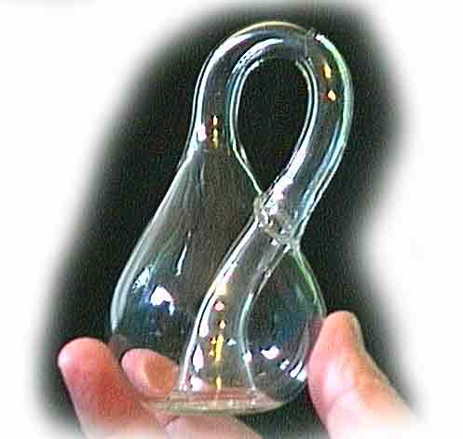

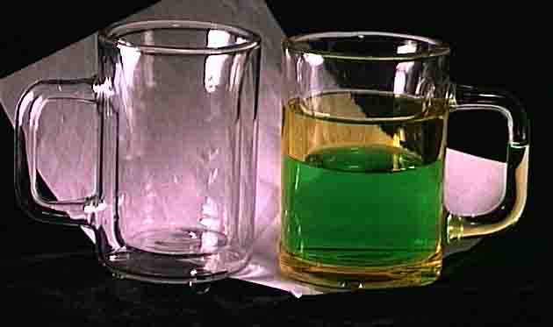
Example of modeling process
How many m&m’s can fit in a zero volume Klein bottle?
[Or how can Dr. Tao get a free Klein beer stein?]

Slide 2
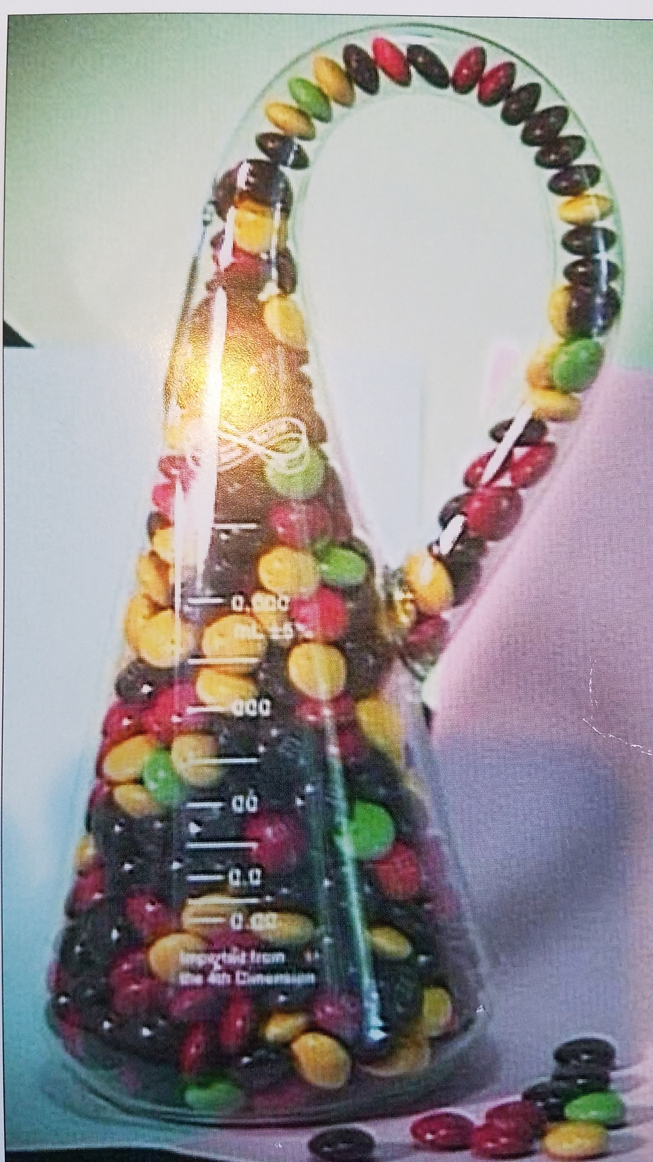
How many m&m’s fit in a zero volume Klein bottle made from a 500 mL Erlenmeyer flask?
Task: Develop a model to calculate the number of m*m’s that will fit into a zero volume Klein bottle made from a 500 mL Erlenmeyer flask
Final Model:
# m&m = 1.209*[V+ π*r_{neck}²*L_{neck}]/ [4*π*a²b]
How was this model developed and what assumptions were used?
What is the modeling process?
Background information:
https://en.wikipedia.org/wiki/Klein_bottle
http://www.kleinbottle.com/m%26ms_in_a_klein_bottle.htm

Slide 3
Mechanistic modeling process
Identify what is being requested, e.g. Amounts, rate, time, expense, etc.
Draw a picture of the situation
Note what is involved in the situation with respect to the assumptions given. i.e. think about what is going on in the situation and look at what assumptions are made.. Identify principles, assumptions, basic theories, etc. that apply to problem, e.g. 1st law, conservation of mass, rate of reaction, etc.
Identify parameters/variables and give each one a symbolic name, e.g. Time – t, mass – m, force – f, volume – v, density – r, etc.
Identify fundamental relationships between parameters, as needed, e.g. V = m/r, f = ma
Write the differential/algebraic equations that model the system.
Assemble parameters and principles into relationships with regards to what is being asked.
If possible, test the model or parts of the model on known data/circumstances, i.e. do dimensional analysis, plug in numerical values, etc.
Inspect model for reasonableness, adequacy.
Iterate by changing assumptions and iterate as needed to create satisfactory model.

Slide 4
Identify what is being requested, e.g. Amounts, rate, time, expense, etc. Draw a picture of the situation
Goal: How many m&m’s fit in a zero volume Klein bottle made from a 500 mL Erlenmeyer flask?
Note what is involved in the situation with respect to the assumptions given. i.e. think about what is going on in the situation and look at what assumptions are made..
Identify principles, assumptions, basic theories, etc. that apply to problem
The m&m’s fill the flask, so the volume of the flask (V) is occupied by m&m’s.
R=3 cm
3.9 cm
500 mL Erlenmeyer flask
500 mL
b=0.3 cm
a=0.6 cm
m&m

Slide 5
Why develop a model?
Why not just do the experiment and forget about the quantitative model?
Research approach: Just fill the flask, pour out the m&m’s, then count them.
Actual measurements give # of m&m’s as 547 and 549 +/- 3
Why might this not be the most efficient, cost effective way to do accomplish this task, particularly for more complex problems like genetic engineering, pharmaceutical production, food processing, etc.?

Slide 6
Iteration 1 start simple! (why?) Identify parameters/variables and give each one a symbolic name Identify fundamental relationships between parameters Assemble parameters into relationships with regards to what is being asked. Test the model, Inspect answer to make sure it is reasonable.
Assumptions:
m&m is sphere, r_{m}=0.5 cm V_{mm}=4/3*π*r_{m}³ = 0.5235 cm³
total volume, V_{total} = 500 mL
The m&m’s occupy the entire total volume, therefore, # m&m’s = V_{total}/ V_{mm}
500/0.5235 = 955.1 m&ms in Klein flask
Model: # m&m = V_{total}/ [4/3*π*r_{m}³]
Notes: Model result is high vs. reality (not satisfactory)
What assumptions might you change to improve the model?

Slide 7

Iteration 2 m&m is not a sphere
b=0.3
a=0.6
Assumptions: m&m is an oblate spheroid
V_{mm}=4/3*π*a²b= 0.4524 cm³
500/0.4524=1105.2 m&m’s
Model # m&m = V_{total}/ [4/3*π*a²b]
Notes:
Used new knowledge to make assumptions more realistic
Evaluation indicates model is still high vs. reality. (Why?)
What assumptions might be changed to improve the model?

Slide 8

Iteration 3 m&m’s do not fill entire space, i.e. void space exists
Assumptions: Hexagonal center cubic packing
Filled volume = 4/3*π*a²b /[4*π*a²b/1.209] = 0.4031
(40.31 % of space is filled by m&m’s)
(500/0.4524)*0.4031=445.5 m&m’s
Model # m&m = V_{total}/ [4*π*a²b/1.209]
Notes:
Model results have improved but about 25% low (not satisfactory)
What assumptions might you change to improve this model?

Slide 9
Iteration 4 account for flask neck volume
Assumptions:
Flask neck volume is a right cylinder and is unchanged by stretching glass shape
V_{neck}= π*r_{neck}²*L_{neck} = π*(3 cm)²*(3.9 cm) = 110.3 cm³
V_{total}=500+110.3 = 610.3 cm³
610.3/0.4524*0.4031=543.8 m&m’s
Model # m&m = 1.209*[V+ π*r_{neck}²*L_{neck}]/ [4*π*a²b]
Notes:
Model is satisfactory (about 1% off reality)
How might you improve this model? Is there ever a perfect model?
R=3 cm
3.9 cm
500 mL

Slide 10
Model utility
Could this model be used for other size Erlenmeyer flasks?
How about other shape containers?
Experimental research vs. engineering modeling
Recognize the cost/effort to do experimental research in molecular biology/human testing (or any other complex scientific endeavor).
So why is engineering modeling valuable?

Slide 11
The purpose of this example is to demonstrate the iterative modeling process that you are being asked to use in this course. A couple comments:
Start simple.
In this example, the technical knowledge set used is most likely very familiar to most of you. However, as the model iteration progresses, it may become increasingly less familiar. This is true for your project modeling as well. You should start simple, but as the modeling process progresses, you will need to learn/assume/utilize increasingly complex concepts. This means you will need to do reading/research on your topic to gain new knowledge/insights. In some cases, there may not be knowledge available (the normal case) so you need to learn how to make assumptions relevant to your topic. I
2. Need to understand concepts
In this example, the knowledge used was geometrical. In the case of biological and food engineering, it will encompass many topics, e.g. biology, chemistry, physics, thermodynamics, physical properties, chemical/physical reactions, transport phenomena, etc., in other words, topics you have previously studied, hence the importance of understanding the concepts learned. Note that in many cases, these may be models themselves, e.g. Newton’s law, Michealis-Menten equation, Fourier’ law, etc. Knowing the assumptions of these models will help improve your model, as often these models are not adequate for complicated biological systems.
3.Iterate
It is useful to note assumptions as you iterate to help improve the model. It will also help in the evaluation/improvement/iteration process the model. Iteration is sometimes viewed as painful/slow, but it is necessary process in modeling.

Slide 12
Suggestion
Optimization of effort/time
You will undoubtedly be tempted to save time/optimize by skipping steps in the modeling process or trying to combine multiple assumptions in each iteration. This is usually to save time and reach the end goal with less effort.
While not a bad thing to do, for complex projects, this often results in making mistakes, getting confused/lost in assumptions, and making errors, which result in actually spending more time and becoming frustrated.
This is particularly true for complex biological processes.
For the purposes of this class, please start simple and use multiple iterations. Learn the process before you try to jump faster and skip steps.

Slide 13
Mechanistic Modeling process
Identify what is being requested, e.g. Amounts, rate, time, expense, etc.
Draw a picture of the situation
Note what is involved in the situation with respect to the assumptions given. i.e. think about what is going on in the situation and look at what assumptions are made.. Identify principles, assumptions, basic theories, etc. that apply to problem, e.g. 1st law, conservation of mass, rate of reaction, etc.
Identify parameters/variables and give each one a symbolic name, e.g. Time – t, mass – m, force – f, volume – v, density – r, etc.
Identify fundamental relationships between parameters, as needed, e.g. V = m/r, f = ma
Write the differential/algebraic equations that model the system.
Assemble parameters and principles into relationships with regards to what is being asked.
If possible, test the model or parts of the model on known data/circumstances, i.e. do dimensional analysis, plug in numerical values, etc.
Inspect answer to make sure it is reasonable.
10. Iterate by changing assumptions and iterate as needed to create satisfactory model.

